Slide 1
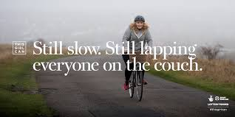
Want to cut your risk of diabetes by 40% without taking tablets or dieting?
…and also cut your risk of breast and bowel cancer, heart disease and dementia by up to 35%?
It sounds too good to be true but these are all benefits of being physically active!
Just increase your activity levels by 10 minutes at a time, aiming for 150 minutes a week. You don’t have to be Mo Farah, just find an activity that you enjoy and build up gradually. You will sleep better and fight stress too!

