Slide 1
Statistics for the AKT
GP ST2 Group, 28/9/11
Tom Gamble

Slide 2
About the Session:
‘Evidence interpretation’ questions form 10% of AKT marks
RCGP also refers to this section as:
‘research and statistics’ and
‘critical appraisal and evidence based clinical practice’
Topics covered in today's presentation:
Clinical testing/contingency tables
Clinical study types and interpretation of results
Significance testing (null hypothesis, type I and II errors)

Slide 3
Practice Makes Perfect:
Best way to learn this subject area is through practice- Passmedicine, Pastest and other websites. Severn Deanery AKT course
If you want to know more or are struggling consider buying/borrowing ‘Medical Statistics Made Easy’ – Michael Harris
Areas not covered today: averages; meta analysis/Forest plots; t-testing; standard error of the mean; funnel plots; relative risk reduction and more

Slide 4
Clinical Testing/Contingency Table
What does the sensitivity of a test tell you?
What about specificity?
Have you heard of positive and negative predictive values of a test?
Contingency table can be used to calculate these figures from raw data - for example when assessing the effectiveness of an investigation or screening test.
Remember – sensitivity/specificity look at when the disease is present/not present, positive and negative predictive value look at when the test is positive or negative.

Slide 5
How to calculate accuracy of a test
 | Disease Present | Disease Absent
Test Positive | TP | FP
Test Negative | FN | TN
Sensitivity=
TP/ (TP+FN)
Specificity=
TN/ (TN+FP)
Positive predictive value= TP/(TP+FP)
Negative predictive value= TN/(TN+FN)
TP= True positive
FP= False positive
FN= True negative
TN= True negative

Slide 6
An example:
A new ‘spot’ blood test has been developed to screen for tuberculosis. 450 UK immigrants were tested using the spot test, and then more detailed examination and testing determined whether or not they had the disease. The test was positive in 40 of the 50 people who had TB. Of the 400 people who didn’t have TB, 40 had a positive test.
Using this data calculate the sensitivity, specificity, PPV and NPV of the new test.

Slide 7
Answers:
Sensitivity=40/50 = 80%
Specificity=360/400 = 90%
PPV = 40/80=50%
NPV=360/370= 36/37 (almost 1)

Slide 8
Some Types of Study Design:
What are the advantages and disadvantages of the following study designs:
Randomised controlled trial
Cohort Study
Case control Study
Cross sectional Survey

Slide 9
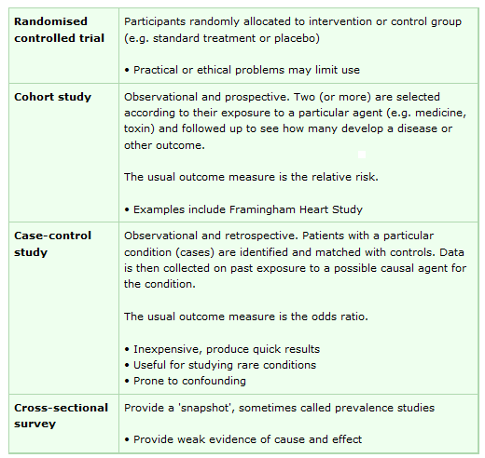

Slide 10
Absolute risk reduction and number needed to treat (RCT)
Absolute risk reduction is the difference between the event rate in the control, and the event rate in the intervention group.
ARR= CER – EER
(CER is control event rate, EER is experimental event rate)
The number needed to treat (NNT) can be calculated by dividing 1 by the ARR
NNT=1/ARR

Slide 11
An example
A study looks at whether a new inhaler reduces asthma exacerbations. In the control group there were 100 people and 40 suffered exacerbations over the year. In the treatment group there were 80 people, 24 of whom suffered exacerbations.
What are the absolute risk reduction and number needed to treat?

Slide 12
Answer:
 | Control group | Inhaler group
People with exacerbations | 40 | 24
Total number of people | 100 | 80
ARR= Control event rate- experimental event rate
ARR = 40/100 – 24/80
= 4/10-3/10
= 1/10
NNT =1/ARR
=10

Slide 13
Relative Risk (Cohort Study/RCT)
Relative risk is the ratio of an event occurring in the experimental/exposed group to the risk of the event occurring in the control group
RR = EER/CER
(CER is control event rate, EER is experimental/exposed event rate)
If the relative risk is less than one then the risk of the outcome is reduced by the exposure. If it is more than one, the risk is increased.
If the confidence interval includes 1 then the result is not significant

Slide 14
An example:
A cohort study looks at whether playing violent computer games leads to criminality. 500 teenage boys who enjoyed playing on ‘Grand Theft Auto’ were followed up over the next 30 years. Of this 500, 150 ended up with criminal records. In the control group there were 400 boys, none of whom owned Playstations. 40 became convicted criminals.
What is the relative risk of the boys becoming criminals after exposure to this award winning computer game?

Slide 15
Answer:
 | Exposed Group | Control Group
Became criminals | 150 | 40
Total number of people | 500 | 400
Relative risk = Exposed Event Rate/Control Event Rate
RR = EER/CER
=150/500 ÷ 40/400
=3/10 ÷1/10
=3
As the relative risk is greater than 1 there was an increased risk of criminality after exposure to Grand Theft Auto.

Slide 16
Odds Ratio (Case control study)
Compares the ‘odds’ of an event occuring in one group compared to another, and indicates the strength of a possible association between the two
 | Outcome
Exposure |  | Yes | No
 | Yes | a | b
 | No | c | d
The ‘odds’ of exposure:
in the ‘disease’ (+ve outcome) group = a/c
in the ‘control’ (-ve outcome) group = b/d
The ‘odds ratio’ = a/c ÷ b/d
= ad/bc

Slide 17
An example:
A study looks at whether people with tennis elbow are more likely to have played tennis in the last year. They took 30 people with tennis elbow and compared them with 30 people without. In the tennis elbow group 15 had played tennis in the last year. In the control only 5 had. What is the odds ratio?

Slide 18
Answer:
 | Outcome
Exposure |  | Yes | No
 | Yes | 15 (a) | 5 (b)
 | No | 15 (c) | 25 (d)
Odds of having played tennis for those with tennis elbow = 15/15 = 1
Odds of having played tennis for those without tennis elbow = 5/25 =1/5
Therefore odds ratio = 1 ÷ 1/5 = 5
Or: Odds ratio = ad/bc
=15x25/5x15
=25/5 = 5

Slide 19
Significance Testing
What is the ‘null hypothesis’ of a study?
The default position: that a treatment makes no difference; that two treatments are equally effective; that there is no relationship between 2 variables
What is the ‘power of a study’
The probability of a study correctly rejecting the null hypothesis if the null hypothesis is false

Slide 20
Significance Testing 2
What is a ‘type 1 error’
When a study incorrectly rejects the null hypothesis
What is a ‘type 2 error’
When a study incorrectly accepts the null hypothesis

Slide 21
Significance Testing 3
The ‘power’ of a study is the probability that a study will correctly reject the null hypothesis
= 1 – probability of a type 2 error
The ‘P value’ is the probability of a result being at least as extreme as in the study, if the null hypothesis is true
= the probability of a type 1 error

Slide 22
An example:
A study of 100 babies is designed to demonstrate whether feeding babies spinach for 6 months makes them stronger.
What is the null hypothesis?
What would be the study outcome if it showed a type 1 error, and what would have been the correct outcome?
What about if it showed a type 2 error?

Slide 23
In the study the babies that were fed spinach were on average 30% stronger than the non spinach group. Taking into account the number of babies in the study, the probability of this being simply down to chance was 10%
- What is the P value of this result?
Let’s assume that spinach does increase baby strength. The probability of this study failing to demonstrate a difference was 25%
- What is the power of this study?

Slide 24
The End
© Tom Gamble 2011

