Slide 1
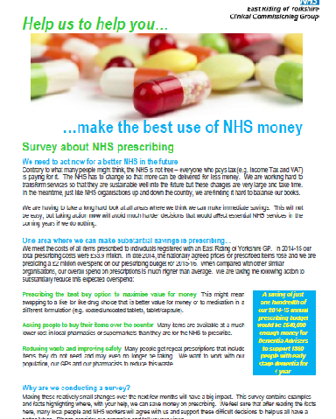
NHS Prescribing – Survey Feedback
486 responses
59 letters
Best buy option 79% Yes
Buy their own items 72% Yes
Reduce waste and improve safety 97% Yes
www.eastridingofyorkshireccg.nhs.uk/prescribing

Slide 2
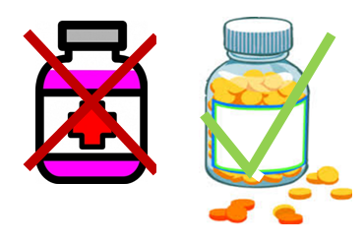
You Said, We Did
Prescribing the best buy option to maximise value for money
We are working with our GPs to ensure patients receive the best treatment for them, with the lowest cost for the NHS.
Patients may see a change in the format (ie from liquid to tablet) but not clinical effectiveness.
Blood glucose meters (for people with type 2 diabetes) will be ISO compliant with strips costing under £10.
“Patients need to be treated as individuals and their varying circumstances considered”
Patients who are directly affected will be contacted by their practice to discuss any individual concerns.

Slide 3
You Said, We Did
Asking people to buy their items over the counter
The Local Medical Committee supported an approach encouraging adults and children to buy their own medication, where appropriate (such as paracetamol, ibuprofen and other items for minor ailments).
This approach promotes short term self care, without the need for a GP appointment.
In response to concerns about gluten-free food items, we agreed a compromise to restrict prescribing to 8 units per month for basic bread loaves, flour and flour mix only.
“GPs should have an appropriate conversation with patients about self-care and having a well-stocked medicines cabinet”

Slide 4
You Said, We Did
Reducing waste and improving safety
We are working with GPs, dietitians and care homes to encourage a food first approach to avoid people becoming malnourished. Sip feeds will be prescribed, where clinically appropriate.
We are planning a waste management campaign to encourage people to only order what medication they need and avoid stockpiling them at home.
“While caring for elderly relative, who has been ordering her own repeat medication, two carrier bags full of over-supply have accumulated.”

