Slide 1
Leadership for MEMs
Tips, examples & possibilities
Liz Spencer

Slide 2
Outline
Relationship between Deanery and Trust
PGME – faculty & team development
Integrate with Trust
Your role as a leader

Slide 3
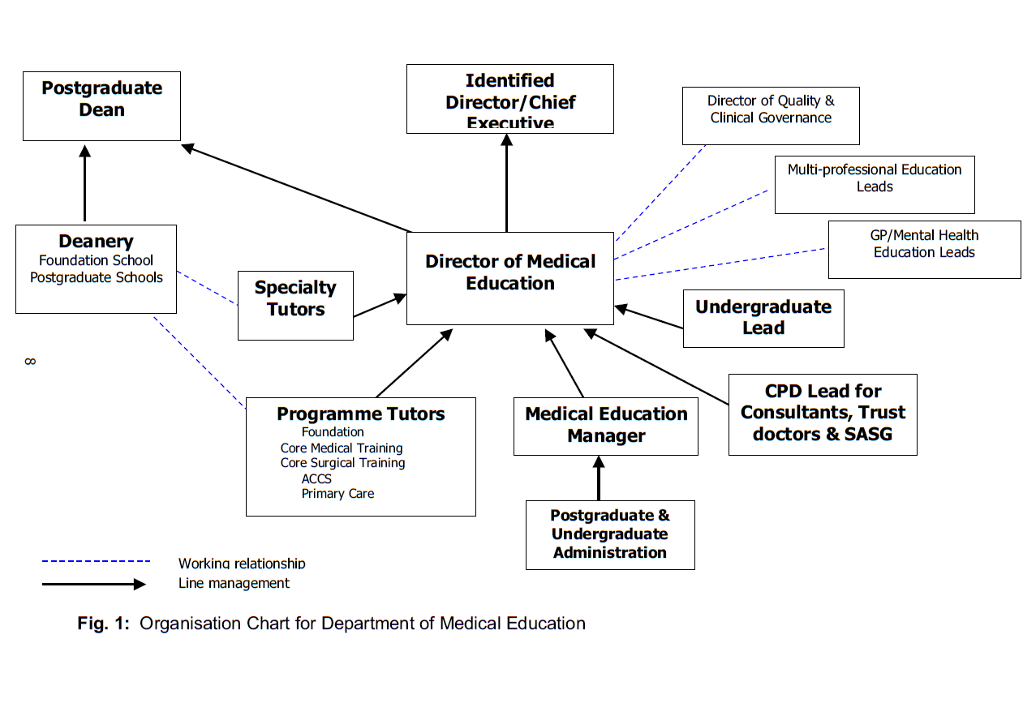
Red Guide 2007

Slide 4
Team
Who is in your team?

Slide 5

Jan 2009

Slide 6
Educational Supervisors must be trained for their role

Slide 7
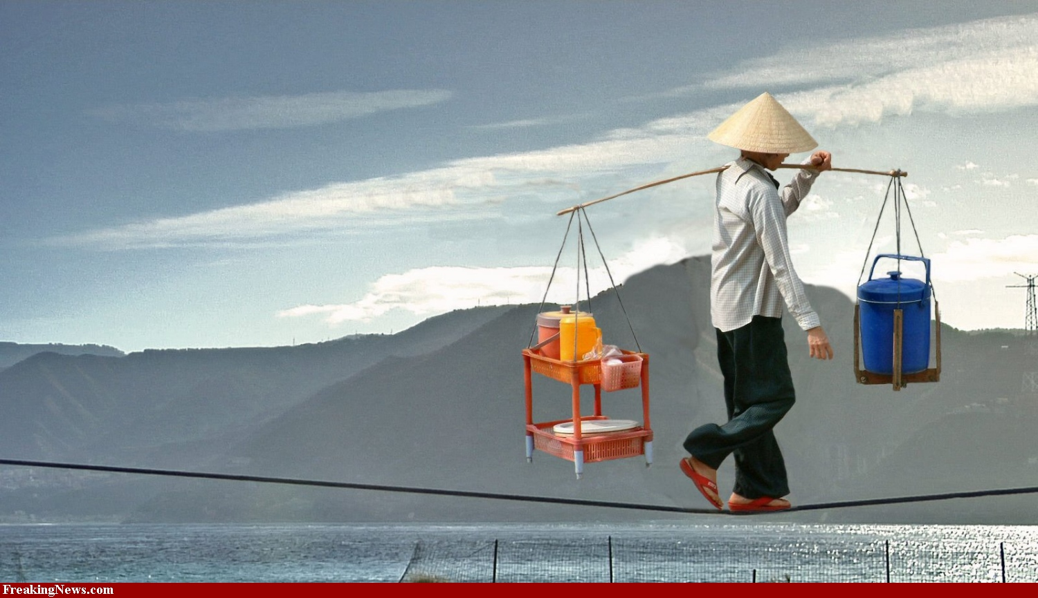
Deanery or Trust

Slide 8
Good Practice
MEM group within the Deanery
Regular communication & sharing of process
Agree strategy in partnership

Slide 9



DME --- MEM
Transactional to Transformational

Slide 10
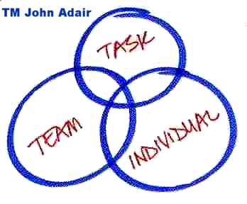
Leadership in action

Slide 11
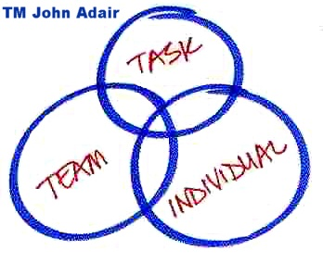
Leadership in action
Achieving the…
Maintaining the…
Developing the …
Notes:
– the first and foremost responsibility. Ensuring that the team members work together effectively as a team through good team-working, clarity of roles, joint problem solving, development and enthusiasm.
- making sure that the team achieves its goals and that team members do what they should be doing – safely, effectively & efficiently.
– making sure that people have the knowledge and skills they need to perform well, treating people fairly and without discrimination, building effective relationships, having good communication skills, improving their skills and effectively handling conflict.

Slide 12
Roles & Responsibilities of College Tutors AoMRC Nov 2004
All Tutors should receive initial training organised by own college by lead postgrad Dean for the specialty + annual College meeting for its college tutors
AoMRC to produce generic guidance for College Tutors, supplementing specialty-specific guidance from individual colleges
College tutors should be appraised annually – part of whole-practice appraisal for consultants

Slide 13
Anaesthetic College Tutors
“responsible for organisation and co-ordination of training”
84% not necessary for Tutors to have teaching qualification
Appraisal/assessment | 23%
Train trainer/how to teach | 20%
Recruitment & selection | 8%
Education supervision | 7%
Mentoring | 6%
Equality & Diversity | 5%
Managing difficult trainee | 3%
Responsibility falls to individual, RCoA, Deanery and employing hospital
Rashid A, Doger A, Gould G. National survey of College Tutors in the UK BJA 2008 100:42-4

Slide 14
Do College Tutors require training and understanding in educational principles?
Or are they just managers of the process?

Slide 15
Role of Specialty / College tutor
Leader for PGME in dept
Support, develop education supervisors
Advise on trainees in difficulty
Link to School and to PGME
Responsible for Quality Control
MEM’s role - recruitment, appraisal, admin support
Notes:
WHO’s job is to get them
What admin support is needed

Slide 16
Appraisal of faculty
Level 1
Associates / deputies
FP tutors/directors
College / specialty tutors

Slide 17
Specialty Tutor support (appraisal)
Direction, instruction & encouragement
Conveying your vision & expectations
Constructive discussion of trainee / dept feedback
Encourage creativity
Gather specialty information
Offering ideas to enhance performance
Talent spotting

Slide 18
Motivation – 7 tips
Involve them – share ideas, seek solutions
Communicate frequently – updates etc
Celebrate & Share good performance
Set challenging goals – they will try to achieve
Provide necessary tools – materials, training
Manage poor performance
Believe in & appreciate your team
SAY THANK YOU frequently

Slide 19
Do DMEs / MEMs require training and understanding in educational principles?
Or are they just managers of the process?

Slide 20
Your role
BLIME
Basics for Leadership In
Medical Education
Leadership
Education
Management

Slide 21
What’s your role?
February 2011

Slide 22
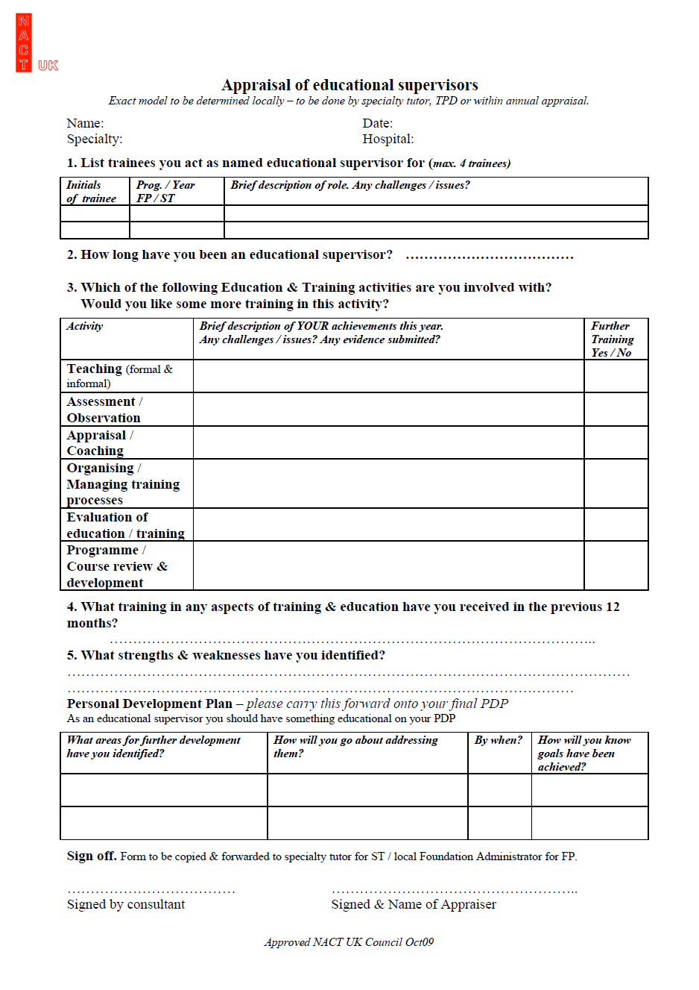
Appraisal of Faculty
Supporting information
- personal record of activity
- feedback on performance
- reflection etc

Slide 23
MEM role in Appraisal of Educational role
Embed into annual NHS appraisal
Ensure all have job description of role
Suggest the NACT UK document is used to provide supporting information
Guidelines for appraiser
  – Deanery/Trust requirements
PDP to contain some educational development

Slide 24
Trust connections
Governance – CQC
Workforce
MPET committee
  Induction & Mandatory training
  Generic skills – IT, communication
  Leadership & Organisational Development
  Nurse & AHP education

Slide 25
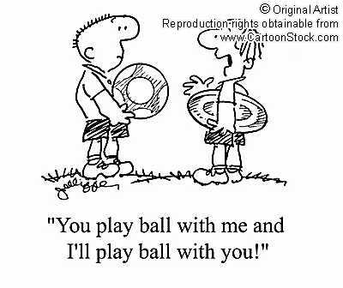

Slide 26
Conclusions
Are you a leader?
Can you make a difference?
How WILL you make a difference
  Write an action plan with timeline

